Slide 1
Project Discussion
17th January 2025

Slide 2
Pipeline
Foundations: This phase focuses on setting up the foundational elements of the project, including data collection, annotation, and preliminary analysis.
Core Development: In this phase, we build the YOLO model, implement pipelines for data processing, and integrate detection and analysis capabilities.
Data Extraction & Trend Analysis: This phase emphasizes extracting insights from data and optimizing pipelines for performance and scalability.
Finalization & Deployment: The final phase involves testing, deployment preparation, production deployment, and delivering the final presentation with documentation.

Slide 3
Current Week Task
Data Collection:
Synthesize 500 charts for each type of chart, i.e. Bar, Line & Pie.
Collect 100 real data-based charts for each chart type
Data Annotation: Annotate all charts
Coming Week Task
Research on OCR tools
Implement OCR on annotated charts

Slide 4
What Techniques does ChatGPT Use?
Image Preprocessing
Computer Vision Models identify chart elements:
Chart Type Recognition (bar, line, scatter, etc.)
Element Identification (axes, data points, labels, legends)
OCR (Optical Character Recognition) extracts textual data
Feature Extraction & Understanding
Extracts data values, trends, patterns (e.g., peaks, correlations, outliers)
Integrates textual information for contextual understanding
Analysis Generation
Trend Analysis: Identifies rising/falling trends
Statistical Inference: Detects averages, correlations, anomalies
Insight Generation: Summarizes key observations
Natural Language Generation
Generates human-readable reports explaining data trends
Provides insights in clear, structured text

Slide 5
What Techniques does ChatGPT Use? (contd)
Technologies Used:
Computer Vision Models: (CNNs, Vision Transformers, OpenAI’s CLIP)
OCR Tools: (Tesseract, OpenAI’s text extraction)
LLMs (Large Language Models): (GPT-4 for interpretation and text generation)
Workflow Overview
Chart Input → User uploads a chart.
Image Processing → Computer Vision extracts elements.
Data Interpretation → Trends, values, and context are parsed.
Text Generation → GPT-4 generates a structured analysis.
Output → A user-friendly summary is provided.

Slide 6
Why Use YOLO?
YOLO is considered to be the state-of-the-art for Object Detection
YOLO is faster in comparison to Faster R-CNN model
YOLO generalize well with new and unseen images
YOLO predicts bounding boxes and class probabilities

Slide 7
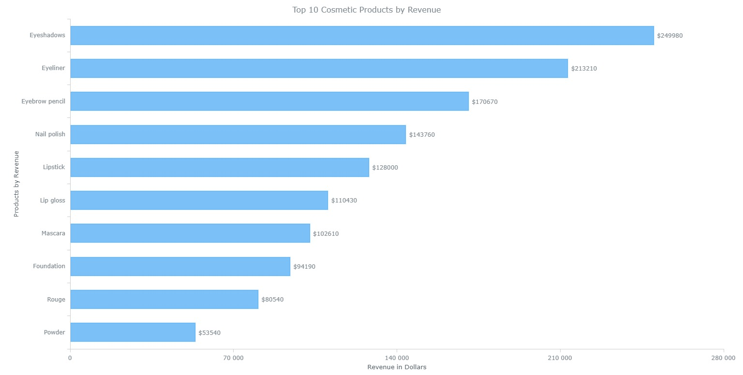
Sample Annotation

Slide 8
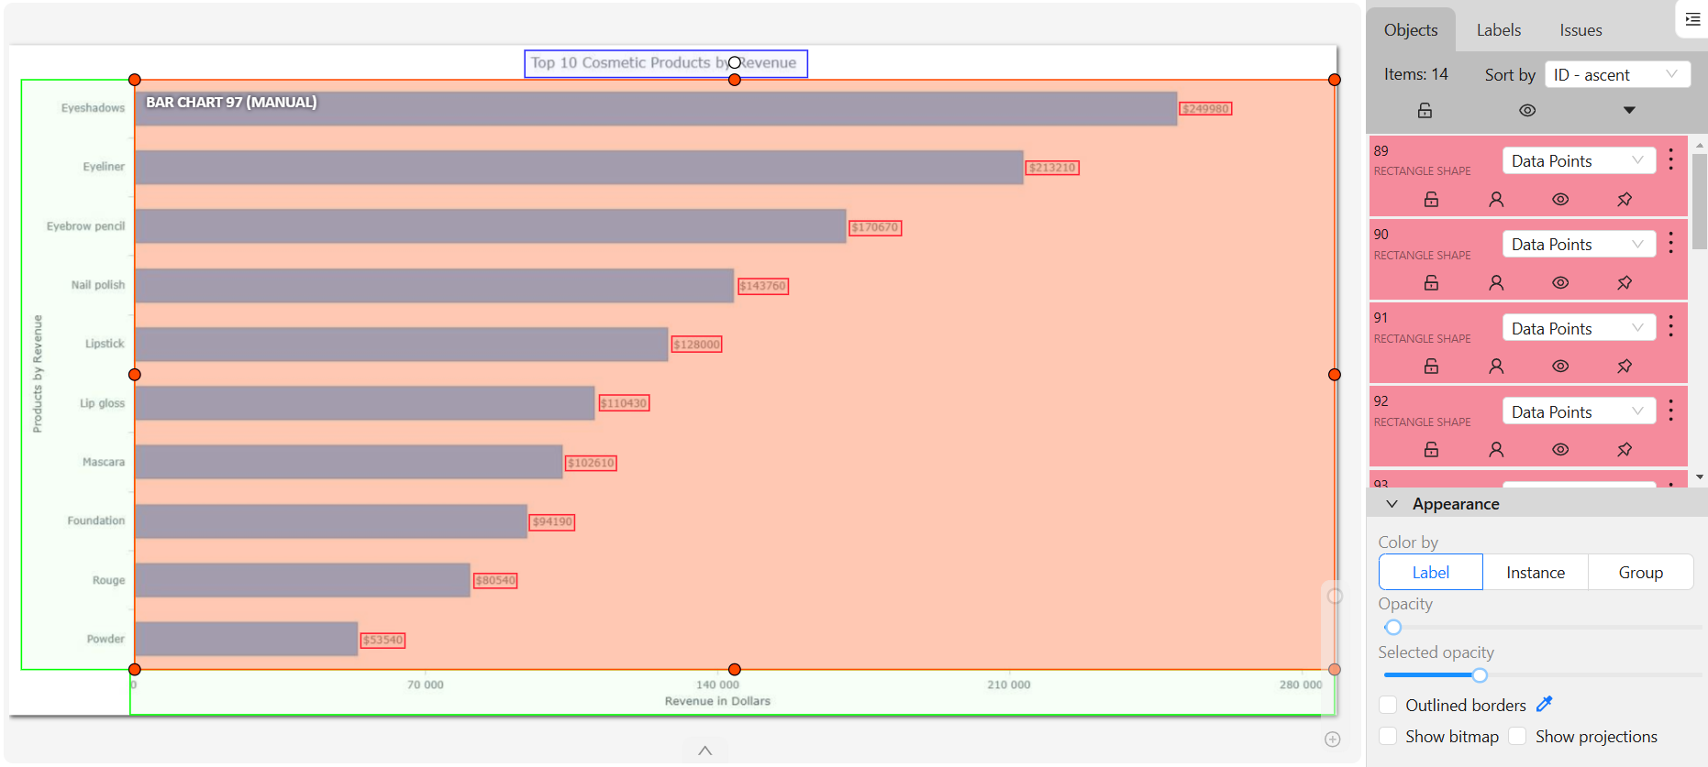
Sample Annotation

Slide 9
MoM
Combination charts – bar and line
What is OCR and how it works
How will you solve for a non labeled charts
How to map X axis value with Y axis
What algorithm will work for the above issue
YOLO walkthrough
OCR walkthrough
Why YOLO, briefing about Fast R CNN, etc.

